Slide 1
Gla university, Mathura Computer Science Engineering
Topic:- E Voting System
Date:-
Archi Agarwal(2115000194)
Ashmit Garg(2215990015)
Hemant Kumar(2215990030)
Rhythm Chaurasia(2215990049)

Slide 2
Introduction
Introduce
Introduce the current landscape of traditional voting methods
"In the current electoral landscape, citizens participate in the democratic process through traditional voting methods, often involving physical presence at polling stations."
Highlight
Highlight the need for change
"However, the limitations of these traditional methods, such as geographical constraints and time commitments, have sparked a need for a more inclusive and convenient approach to voting."
Address
Address the advantages of transitioning to an online voting system
"The Online Voting System addresses these challenges, offering a revolutionary approach that enhances accessibility, convenience, and overall efficiency in the electoral process."

Slide 3
Objectives
Clearly define the primary objectives of implementing the Online Voting System
"The Online Voting System is designed with the following key objectives in mind, aiming to transform and enhance the electoral process:"
Enhancing Voter Participation
"Increase voter turnout by providing a convenient and accessible platform for citizens to exercise their democratic right."
"Eliminate barriers that may prevent certain demographics from participating in traditional voting methods."
Ensuring Integrity and Security
"Implement robust security measures to safeguard the voting process against potential threats and fraud."
"Maintain the integrity of the election results, ensuring that each vote is accurately recorded and counted."

Slide 4
Methodology
The system designing process starts when the research has been completed about the languages that will be used in the development of a website to achieve the task. Following languages are used:
HTML
CSS
JavaScript

Slide 5
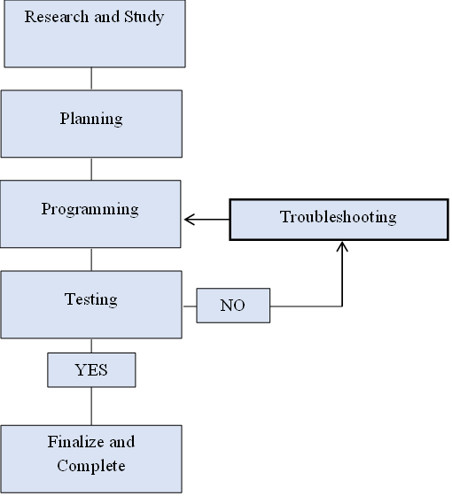
Methodology

Slide 6
System Architecture
Present an overview of the technical architecture of the Online Voting System
01
"The Online Voting System is a robust and well-structured platform comprising three main components, each playing a crucial role in ensuring a seamless and secure electoral process."
Front-end
02
"The user interface, built using HTML and CSS, provides voters with an intuitive and user-friendly experience."
"Emphasis on responsive design to ensure accessibility across various devices."

Slide 7
System Architecture
Page 1: - Login page
The first page of our project is the login page. Here, the user has to authenticate by his name, Aadhar id. By authenticating, he/she will be eligible to vote for any party. It is done by the use of HTML & CSS.
Page 2: - About the parties
The second page of our project is About the parties. Here, the user has to select the party to which he/she wants to vote. There are 10 parties contesting in this election.
Page 3: -
After selecting the party, the user has to select the following things: -
Election type: - User has to select the election type i.e. Lok Sabha election or Legislative election.
State: - User has to select his state to which he belongs and also has to enter its pin code.

Slide 8
System Architecture
Page 4: - Selecting the parties which you have to vote.
After going through the above steps, now user can cast his/her vote to any party contesting and then user has to submit its vote. After the vote submission, “Thank you, you have successfully submitted your vote” will appear.
Note: - After successfully submitting the vote, the user cannot see the count of votes given to any party

Slide 9
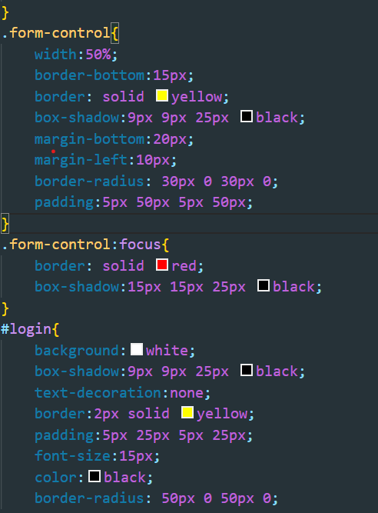
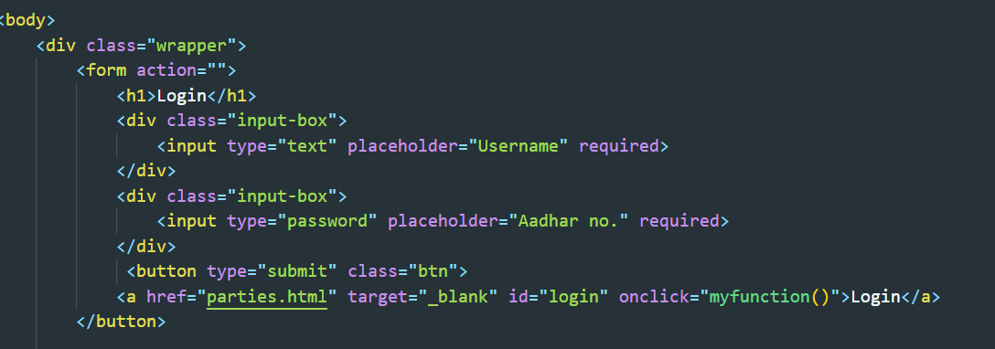
Implementation

Slide 10
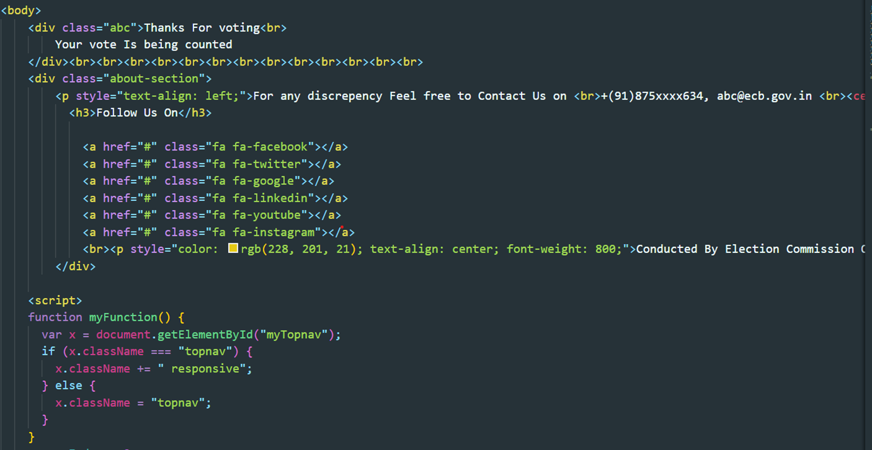
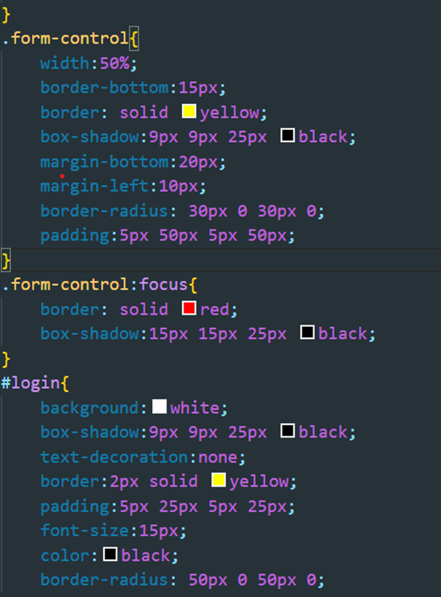
Implementation

Slide 11
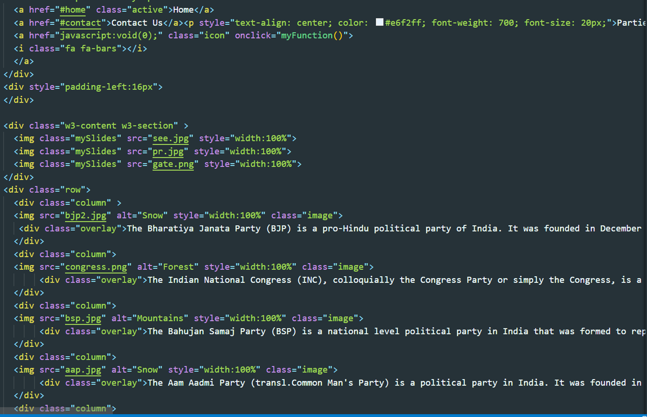
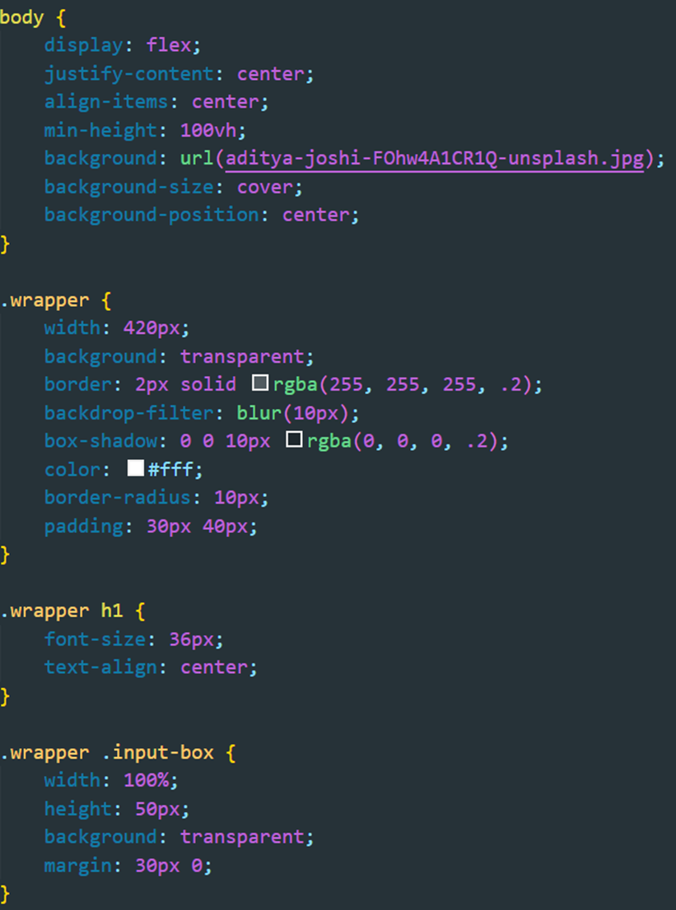
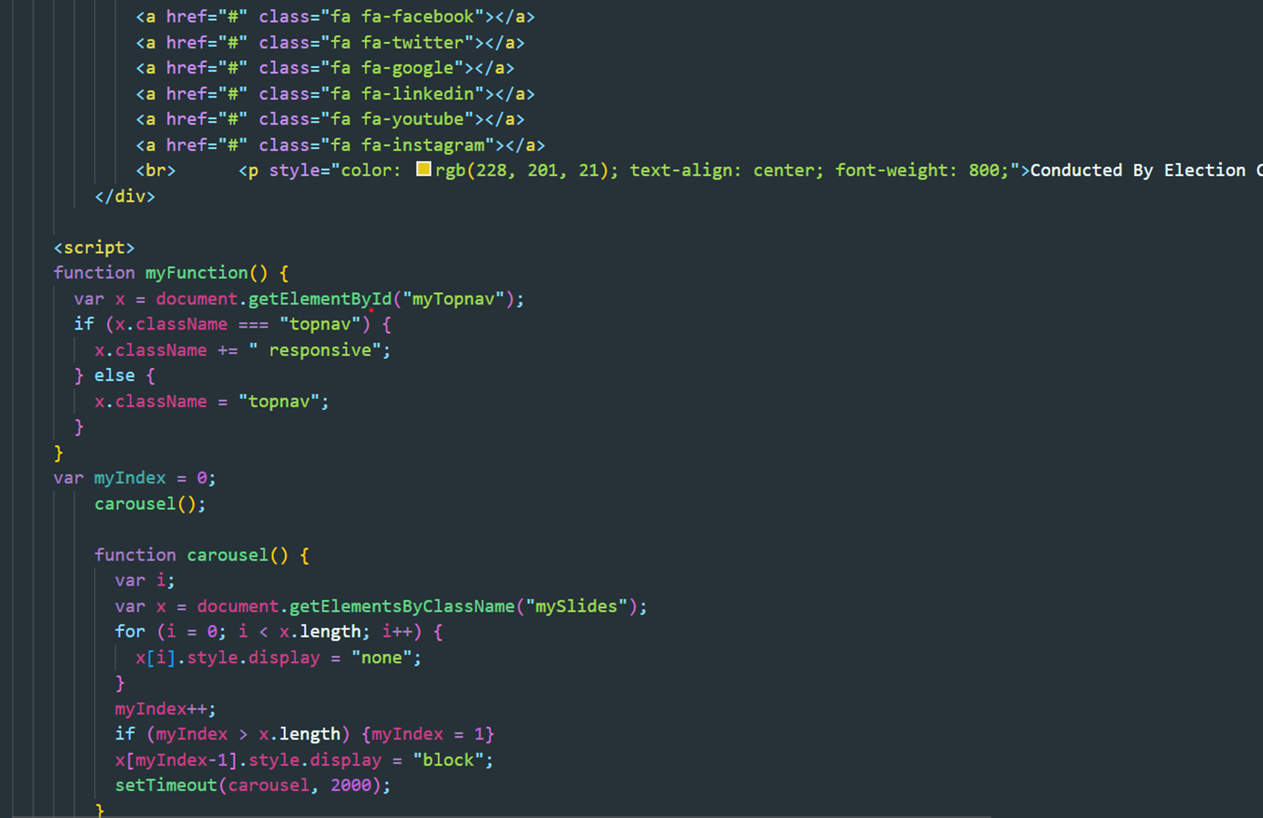

Slide 12
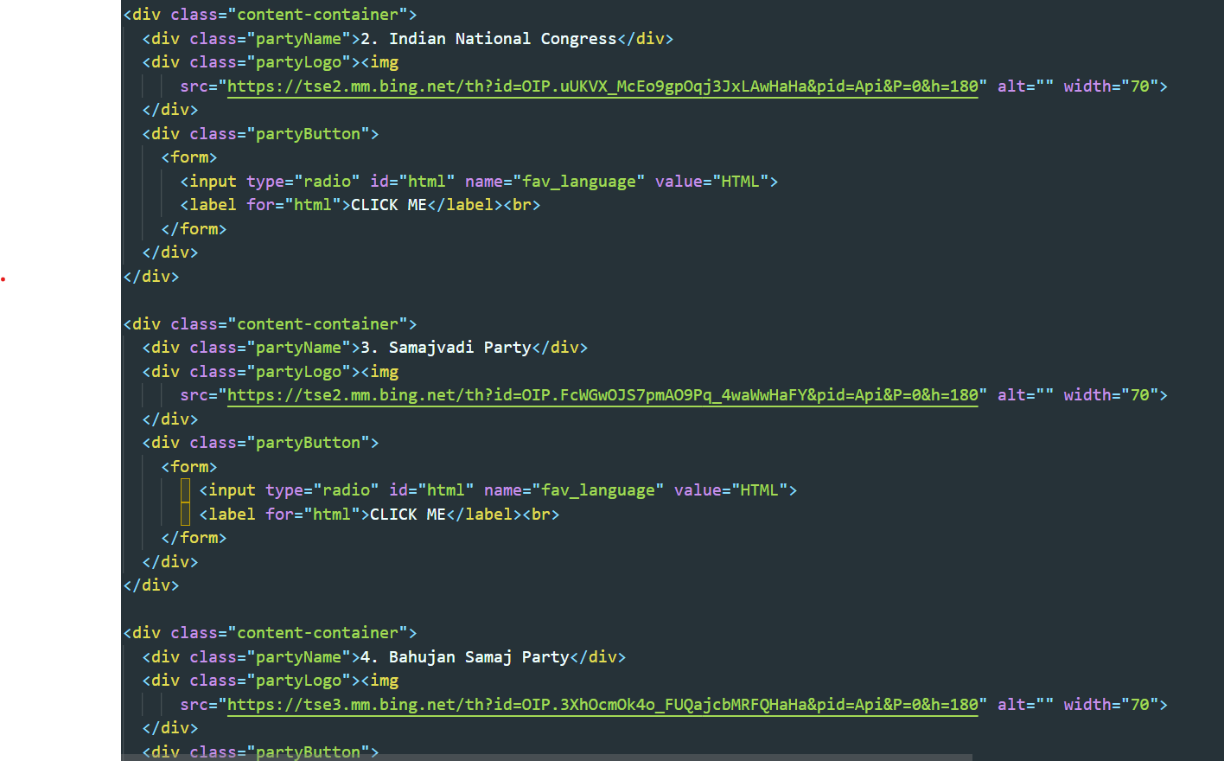
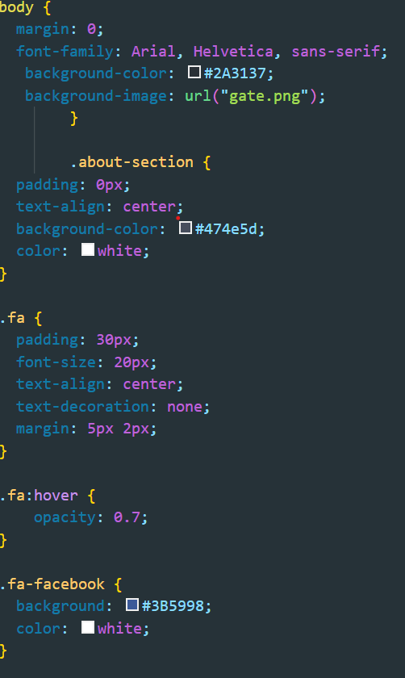

Slide 13
Features
Briefly introduce the key features and functionalities of the online voting system
Example: "Now that we understand the importance of online voting systems, let's delve into the features and functionalities that make them a robust and secure means of democratic participation."
Highlight the intuitive design for ease of use
Example: "Our online voting system boasts a user-friendly interface, ensuring a seamless and accessible experience for all voters. The design prioritizes clarity and simplicity."
Emphasize the importance of secure user authentication
Example: "We prioritize the security of each vote. Our system employs robust user authentication methods, including multi-factor authentication, to ensure the legitimacy of each voter."

Slide 14
Features
Explain the flexibility of the system in accommodating various voting scenarios
Example: "Tailor your voting experience! Our system allows for customizable ballots, accommodating different election formats and ensuring a versatile platform for a range of voting scenarios."
Showcase the system's capability to provide real-time updates
Example: "Stay informed with real-time updates. Our online voting system keeps voters in the loop with instantaneous results, fostering transparency and trust in the electoral process."

Slide 15


Features
Assure the audience of the system's commitment to voter privacy and data security
Example: "We prioritize the anonymity of each voter. Our system employs advanced encryption techniques to safeguard voting data, ensuring a secure and confidential electoral experience."
Discuss features that make the system accessible to a diverse range of users
Example: "Accessibility matters. Our system is designed with features such as screen reader compatibility and language options, making it accessible to voters with diverse needs."

Slide 16
Results
Details the process of how election results are processed and verified in the Online Voting System
"Ensuring the accuracy and transparency of election results is paramount in our Online Voting System. Here's how we achieve this:"
Results Processing
"Votes are securely tallied in real-time as they are cast, ensuring timely and accurate results."
"The system employs advanced algorithms to process and consolidate voting data, minimizing the margin of error."
Voter Verification
"Post-voting, a robust verification process is initiated to confirm the legitimacy of each vote."
"Voters receive a confirmation of their vote, and a secure verification mechanism ensures the authenticity of the entire voting process."

Slide 17
Challenges Faced
Acknowledge the potential challenges faced during the implementation of the Online Voting System
"While the Online Voting System offers numerous advantages, its implementation is not without challenges. We address these challenges proactively to ensure a secure and reliable voting experience."
Security Concerns
"Ensuring the highest level of security is a constant challenge, as the system must defend against potential cyber threats and attacks."
"Regular security audits and updates are conducted to stay ahead of emerging risks and vulnerabilities."

Slide 18
Challenges Faced
Accessibility Barriers
"Not all citizens may have equal access to the internet or digital devices, posing a challenge to the inclusivity of the system."
"Efforts are made to bridge the digital divide, providing alternative voting methods for those facing accessibility challenges."
Public Trust
"Building and maintaining public trust in the Online Voting System can be challenging, especially in the face of concerns about the security and integrity of online voting."
"Educational campaigns and transparent communication are essential to address and alleviate these concerns."

Slide 19
Future enhancements
Discuss the ongoing commitment to innovation and improvement in the Online Voting System
"Our dedication to excellence doesn't end with the current implementation of the Online Voting System. We envision continuous evolution and improvement, exploring future enhancements that align with emerging technologies and changing needs."
Integration with Blockchain Technology
"Exploring the integration of blockchain to further enhance the security and transparency of the voting process."
"Blockchain's decentralized nature could provide an additional layer of trust and integrity to our system."

Slide 20
Future enhancements
User Experience Upgrades
"Continuous efforts to enhance the user experience through user feedback and technological advancements."
"Updates to the interface, accessibility features, and overall usability to ensure a seamless and intuitive voting experience."
Adaptability to Changing Technology
"Staying abreast of technological advancements and ensuring the system's adaptability to new technologies as they emerge."
"A commitment to remain at the forefront of innovation in the electoral technology landscape."

Slide 21
Conclusion
Summarize the main points covered throughout the presentation
Example: "As we conclude our exploration of the Online Voting System, let's recap the key points that highlight the transformative potential of this technology in modernizing democratic processes."
Reiterate the benefits of online voting systems
Example: "We've seen how online voting enhances accessibility, reduces costs, and improves accuracy. These benefits underscore the compelling case for the integration of online voting into our democratic framework."

Slide 22
Conclusion
Acknowledge the challenges discussed and emphasize ongoing efforts to address them
Example: "While we acknowledge the security concerns and accessibility challenges, it's essential to recognize that ongoing technological advancements and rigorous security measures are continuously addressing these issues."
Highlight the significance of HTML, CSS, and PHP in building the online voting system
Example: "The use of HTML for the front-end, CSS for intuitive design, and PHP for robust back-end functionality forms the technological backbone of our online voting system, ensuring a seamless and secure experience for users."

Slide 23
Acknowledgment
Express gratitude to individuals and organizations that played a pivotal role in the development and implementation of the Online Voting System
"Implementing an innovative system like the Online Voting System is a collaborative effort. We extend our sincere appreciation to those who have contributed significantly to its development and success."
Development Team
"A heartfelt thank you to our dedicated development team for their tireless efforts in designing, coding, and testing the Online Voting System."

Slide 24
Acknowledgment
Mentor
Lastly, we would like to thank the university administration for providing us with access to essential resources and facilities, which have been instrumental in the successful execution of our project.
we would like to express our heartfelt thanks to our esteemed mentor “Prof. Sanjay Madan” for his unwavering support, valuable guidance, and insightful feedback throughout the duration of this project. His expertise and encouragement have been pivotal in shaping the direction of our work and have inspired us to deliver our best.
University

Slide 25
Thank You…
Express gratitude for the audience's attention and open the floor for questions.

